Slide 1

Abduljalil Abdulmumin Abiri
3rd October, 2021

Slide 2

Outline
Executive Summary
Introduction
Methodology
Results
Conclusion
Appendix

Slide 3
Executive Summary
Summary of methodologies
Data collection
Data wrangling
EDA with data visualization
EDA with SQL
Building an interactive map with Folium
Building a Dashboard with Plotly Dash
Predictive analysis (Classification)
Summary of all results
Exploratory data analysis results
Interactive analytics demo in screenshots
Predictive analysis results
NOTE: EDA - Exploratory Data Analysis

Slide 4
Introduction
Project background and context:
SpaceX is the only company in the world that can reuse the first stage of rocket launch. This means that they are able to save a lot on expenses needed to launch a rocket and thus can provide rocket launches to organizations such as NASA at a much lower cost than rival companies. So as a Data Scientist, we can predict if the first stage of rocket launch will land successfully using data from SpaceX past launches and thus determine the cost of a launch. This information could prove immensely useful to SpaceX rivals.
We want to find answers to the questions below:
The price of each launch.
Which Parameters determine if the first stage can be reused.
What influences a successful rocket landing.

Slide 5


Slide 6
Methodology
Executive Summary
Data collection methodology:
Data on past Falcon 9 launches was collected by scrapping data from the Wikipedia page containing information about every single Falcon 9 launches. We used BeautifulSoup library for web scraping.
Also collected data stored in SpaceX Rest API.
Perform data wrangling
Performed feature engineering on the data and removed irrelevant columns.
Perform exploratory data analysis (EDA) using visualization and SQL
Perform interactive visual analytics using Folium and Plotly Dash
Perform predictive analysis using classification models
How to build, tune, evaluate classification models

Slide 7
Data Collection
The flowcharts below describe how data was collected for the analysis and prediction.
SpaceX REST API
Get HTML Response from Wikipedia
Web scraping HTML data from Wikipedia page
Make GET Request to SpaceX REST API
Extract needed data using BeautifulSoup
API Returns SpaceX data in JSON format
Convert JSON data into a Pandas dataframe
Convert extracted data to Pandas Dataframe

Slide 8
Data Collection – SpaceX API
Request rocket launch data from SpaceX API.
Decode data as JSON file then turn into Pandas DataFrame
spacex_url="https://api.spacexdata.com/v4/launches/past"
response=requests.get(spacex_url)
Get needed column data from each API Endpoint
data=pd.json_normalize(response.json())
def getcolumnName(data): for x in data['rocket']: response=requests.get("https://api.spacexdata.com/v4/endpoint/"+ str(x)).json()BoosterVersion.append(response['name'])
getcolumnName(data)
Where:
columnName includes: LaunchSite, payloadData, coreData etc.
Endpoint includes: launchpads, cores, launch_site, etc.
Construct dataset using data obtained.
launch_df=pd.DataFrame.from_dict(launch_dict)
data_falcon9=launch_df.loc[launch_df['BoosterVersion']!='Falcon 1']
meanPayload=data_falcon9['PayloadMass'].mean()
data_falcon9['PayloadMass'].replace(np.NaN, meanPayload,inplace=True)
GITHUB LINK TO NOTEBOOK
LINK

Slide 9
Data Collection - Scraping
GITHUB LINK TO COMPLETE CODE:
LINK
Request Falcon9 Launch Wikpedia page
Extract all tables and column names from HTML Table using BeautifulSoup Library
static_url = "https://en.wikipedia.org/w/index.php?title=List_of_Falcon_9_and_Falcon_Heavy_launches&oldid=1027686922"
response = requests.get(static_url)
BE4U = BeautifulSoup(response.text)
html_tables = BE4U.find_all('table')
for th in daTH:
name =extract_column_from_header(th)
duh_names.append(name)
if (name!=None) and (len(name) >0):
column_names.append(name)
Create DataFrame from extracted HTML Tables.
Save as CSV file.
launch_dict= dict.fromkeys(column_names)
launch_dict[‘columnName.'] = [] #Where columnName are ‘Flight No’, ‘Launch Site’, ‘Payload’, ‘Payload Mass’ etc.
extracted_row = 0
for table_number,table in enumerate(BE4U.find_all('table',"wikitable plainrowheaders collapsible")):
for rows in table.find_all("tr"):
#Append the columnNames into the strings.. See the complete code in the Github URL provided.
df=pd.DataFrame(launch_dict)
df.to_csv('spacex_web_scraped.csv', index=False)

Slide 10
Data Wrangling
Performed Exploratory Data Analysis on the dataset obtained.
The flowchart describes the process taken for the Data Analysis
Calculated the number of launches on each site.
Calculated the number and occurrence of each orbit
GITHUB LINK TO COMPLETE CODE:
LINK
Calculated the number and occurrence of mission outcome per orbit type
Created a landing outcome label from Outcome column
Saved the new dataset as a csv file named “dataset_part\_2.”

Slide 11
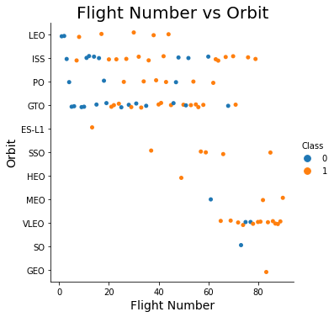
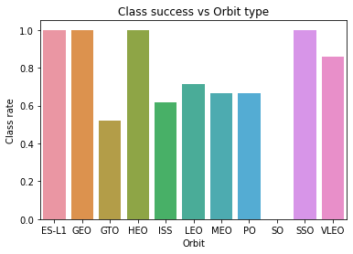
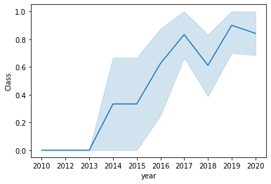
EDA with Data Visualization
The graphs drawn in the analysis are:
Scatter plot graphs: Scatter plot graphs are great at showing the correlation between two continuous variables. Graphs drawn with scatter graph include: Flight Number vs Payload Mass, Orbit vs Flight Number etc.
Bar Chart graph: A bar chart is great at making comparison of metric values across different subgroups of data. The success rate vs Orbit type used the bar chart to show the success rate of each orbit.
Line Graph: A line graph is great at emphasizing changes in values for one variable (plotted on the vertical axis) for continuous values of the second variable (Horizontal axis)
GITHUB LINK TO COMPLETE CODE:
LINK

Slide 12
EDA with SQL
The SQL Queries performed are:
Displaying the names of the unique launch sites in the space mission
Displaying 5 records where launch sites begin with the string 'CCA‘
Displaying average payload mass carried by booster version F9 v1.1
Listed the date when the first successful landing outcome in ground pad was achieved.
Listed the names of the boosters which have success in drone ship and have payload mass greater than 4000 but less than 6000
Listed the total number of successful and failure mission outcomes
Listed the names of the booster_versions which have carried the maximum payload mass. Use a subquery.
Listed the failed landing_outcomes in drone ship, their booster versions, and launch site names for in year 2015
Rank the count of landing outcomes (such as Failure (drone ship) or Success (ground pad)) between the date 2010-06-04 and 2017-03-20, in descending order
GITHUB LINK TO COMPLETE CODE: LINK

Slide 13
Build an Interactive Map with Folium
We added markers for each sites location, we added circles to each site area, We added lines between a launch site to its proximities, We added a markerCluster to group each attempted launch
We added the markers to mark each site location on the map, then we added the circles to highlight a site’s area for easy identification on the map. We added lines to visualize the distances between a launch site to its proximities, finally we added markerCluster to group each attempted launch according to launch site sp as to avoid too much clutter on the map.
GITHUB LINK: LINK

Slide 14
Build a Dashboard with Plotly Dash
The scatter plot interactive graph was added to show the relationship with Outcome and Payload Mass (Kg) for the different booster versions.
Scatter plot was used because it is the best visualization method to show a non-linear pattern.
The Pie chart interactive graph was added to show the total launches by a certain site or all sites together.
Pie chart was selected because it can visualize the relative proportions of different classes of data.
GITHUB LINK TO COMPLETE CODE: LINK

Slide 15
Predictive Analysis (Classification)
Load csv data into pandas DataFrame, Transform data, split data into training and test data sets
Decide which Machine Learning Algorithms to use and set our parameters and algorithms to GridSearchCV
Fit the dataset into the GridSearchCV object and train the model.
Building Model
Check accuracy for each model using P-value and R squared
Get tuned hyper parameters for each type of Machine Learning algorithms.
Plot confusion Matrix
Evaluating Model
Apply feature Engineering to improve model performance
Improving Model
The model with the best accuracy score on the test dataset is chosen as best performing model.
Determining the best Classification model
GITHUB LINK: LINK

Slide 16
Results
Exploratory data analysis results
Interactive analytics demo in screenshots
Predictive analysis results

Slide 17


Slide 18
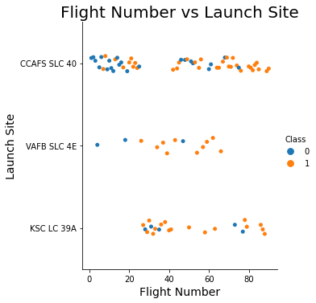
Flight Number vs. Launch Site
From the scatter plot, we see that in general the more flights taken the higher the success rate

Slide 19
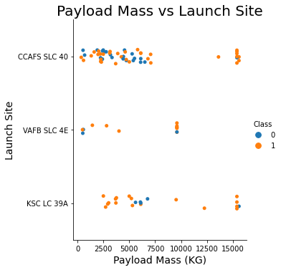
Payload vs. Launch Site
From the scatter plot above, there is no clear relationship between the Mass of the payload and the different Launch Sites.

Slide 20
Success Rate vs. Orbit Type
From the bar chart, we observe that Orbit types ES-LI, GEO, HEO AND SSO have high rates of success.

Slide 21

Flight Number vs. Orbit Type
From the scatterplot, we observe that in the LEO orbit the success seems to be related to the number of flights. There is no clear relationship between flight number when in GTO orbit.

Slide 22
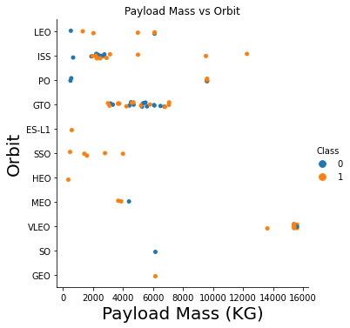
Payload vs. Orbit Type
We observe that the Heavy payloads have a negative influence on GTO orbits and positive on GTO and Polar LEO (ISS) orbits.

Slide 23
Launch Success Yearly Trend
From the Line Chart we can observe that the success rate since 2013 was steadily increasing till 2020.

Slide 24
All Launch Site Names
SQL QUERY - %sql SELECT distinct (Launch_Site) as DLAUNCH from SPACEX2
RESULT -
This shows us all the launch sites where launch attempts were carried out.
dlaunch
CCAFS LC-40
CCAFS SLC-40
KSC LC-39A
VAFB SLC-4E

Slide 25
Launch Site Names Begin with 'CCA'
SQL Query - %sql SELECT * FROM SPACEX2 WHERE LAUNCH_SITE LIKE 'CCA%' limit 5.
RESULT -
DATE | time__utc_ | booster_version | launch_site | payload | payload_mass__kg_ | orbit | customer | mission_outcome | landing__outcome
2010-06-04 | 18:45:00 | F9 v1.0 B0003 | CCAFS LC-40 | Dragon Spacecraft Qualification Unit | 0 | LEO | SpaceX | Success | Failure (parachute)
2010-12-08 | 15:43:00 | F9 v1.0 B0004 | CCAFS LC-40 | Dragon demo flight C1, two CubeSats, barrel of Brouere cheese | 0 | LEO (ISS) | NASA (COTS) NRO | Success | Failure (parachute)
2012-05-22 | 07:44:00 | F9 v1.0 B0005 | CCAFS LC-40 | Dragon demo flight C2 | 525 | LEO (ISS) | NASA (COTS) | Success | No attempt
2012-10-08 | 00:35:00 | F9 v1.0 B0006 | CCAFS LC-40 | SpaceX CRS-1 | 500 | LEO (ISS) | NASA (CRS) | Success | No attempt
2013-03-01 | 15:10:00 | F9 v1.0 B0007 | CCAFS LC-40 | SpaceX CRS-2 | 677 | LEO (ISS) | NASA (CRS) | Success | No attempt
This query displays the first 5 records whose launch sites names begin with ‘CCA’

Slide 26
Total Payload Mass
SQL Query - %sql SELECT SUM(PAYLOAD_MASS__KG_) FROM SPACEX2 WHERE CUSTOMER = 'NASA (CRS)‘
RESULT -
This query calculates and displays the total sum of payload mass for only rows with “NASA(CRS)” as Customers.
SUM
45596

Slide 27
Average Payload Mass by F9 v1.1
SQL Query - %sql SELECT AVG(PAYLOAD_MASS__KG_) FROM SPACEX2 WHERE BOOSTER_VERSION = 'F9 v1.1‘
RESULT –
This query calculates and displays the average payload mass of all rows whose booster version is “F9 v1.1”
AVG
2928.4

Slide 28
First Successful Ground Landing Date
SQL Query - %sql SELECT MIN(DATE) FROM SPACEX2 WHERE Landing__Outcome = 'Success (ground pad)'
RESULT –
This query shows the date of the first successful landing in ground pad.
MIN DATE
2015-12-22

Slide 29
Successful Drone Ship Landing with Payload between 4000 and 6000
SQL Query - %sql SELECT BOOSTER_VERSION FROM SPACEX2 WHERE Landing__Outcome = 'Success (drone ship)' AND PAYLOAD_MASS__KG_ > 4000 AND PAYLOAD_MASS__KG_ < 6000
RESULT –
This Query displays the names of boosters which have success in drone ship and a payload mass between 4000 and 6000.
booster_version
F9 FT B1022
F9 FT B1026
F9 FT B1021.2
F9 FT B1031.2

Slide 30
Total Number of Successful and Failure Mission Outcomes
SQL Query - %sql SELECT COUNT(MISSION_OUTCOME) FROM SPACEX2 WHERE MISSION_OUTCOME = 'Success' OR MISSION_OUTCOME = 'Failure (in flight)‘
RESULT -
This query shows the total number of successful and failure mission outcomes.
Total
100

Slide 31
Boosters Carried Maximum Payload
SQL Query - %sql SELECT BOOSTER_VERSION FROM SPACEX2 WHERE PAYLOAD_MASS__KG_ = (SELECT MAX(PAYLOAD_MASS__KG_) FROM SPACEX2)
RESULT -
booster_version
F9 B5 B1048.4
F9 B5 B1049.4
F9 B5 B1051.3
F9 B5 B1056.4
F9 B5 B1048.5
F9 B5 B1051.4
F9 B5 B1049.5
F9 B5 B1060.2
F9 B5 B1058.3
F9 B5 B1051.6
F9 B5 B1060.3
F9 B5 B1049.7
This Query displays the names of booster versions which carried the maximum payload mass

Slide 32
2015 Launch Records
SQL Query - %sql select landing__outcome, booster_version, launch_site from Spacex2 where YEAR(DATE)='2015' AND Landing__outcome LIKE 'Fail%‘
RESULT –
This query displays the failed landing outcome, booster version and launch site of records for the year 2015.
landing__outcome | booster_version | launch_site
Failure (drone ship) | F9 v1.1 B1012 | CCAFS LC-40
Failure (drone ship) | F9 v1.1 B1015 | CCAFS LC-40

Slide 33
Rank Landing Outcomes Between 2010-06-04 and 2017-03-20
SQL Query - %sql select * FROM SPACEX2 WHERE Landing__Outcome LIKE 'Success%' AND (DATE between '2010-06-04' and '2017-03-20') ORDER BY date DESC
This Query displays records between dates (2010-06-04 to 2017-03-20) in descending order whose landing outcome begins with “Success”.
RESULT -
DATE | time__utc_ | booster_version | launch_site | payload | payload_mass__kg_ | orbit | customer | mission_outcome | landing__outcome
2017-02-19 | 14:39:00 | F9 FT B1031.1 | KSC LC-39A | SpaceX CRS-10 | 2490 | LEO (ISS) | NASA (CRS) | Success | Success (ground pad)
2017-01-14 | 17:54:00 | F9 FT B1029.1 | VAFB SLC-4E | Iridium NEXT 1 | 9600 | Polar LEO | Iridium Communications | Success | Success (drone ship)
2016-08-14 | 05:26:00 | F9 FT B1026 | CCAFS LC-40 | JCSAT-16 | 4600 | GTO | SKY Perfect JSAT Group | Success | Success (drone ship)
2016-07-18 | 04:45:00 | F9 FT B1025.1 | CCAFS LC-40 | SpaceX CRS-9 | 2257 | LEO (ISS) | NASA (CRS) | Success | Success (ground pad)
2016-05-27 | 21:39:00 | F9 FT B1023.1 | CCAFS LC-40 | Thaicom 8 | 3100 | GTO | Thaicom | Success | Success (drone ship)
2016-05-06 | 05:21:00 | F9 FT B1022 | CCAFS LC-40 | JCSAT-14 | 4696 | GTO | SKY Perfect JSAT Group | Success | Success (drone ship)
2016-04-08 | 20:43:00 | F9 FT B1021.1 | CCAFS LC-40 | SpaceX CRS-8 | 3136 | LEO (ISS) | NASA (CRS) | Success | Success (drone ship)
2015-12-22 | 01:29:00 | F9 FT B1019 | CCAFS LC-40 | OG2 Mission 2 11 Orbcomm-OG2 satellites | 2034 | LEO | Orbcomm | Success | Success (ground pad)

Slide 34


Slide 35
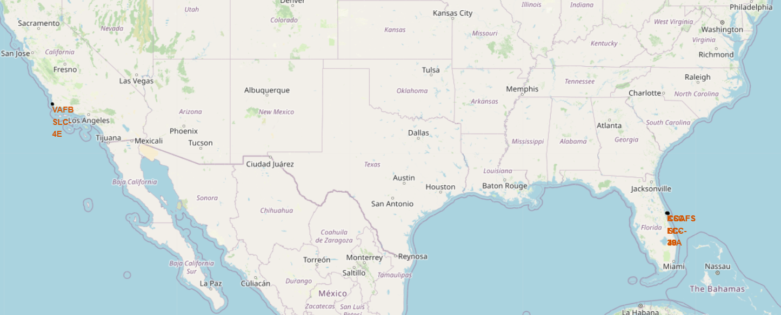
All Launch sites on the world map
The map above shows where all the unique launch sites are. Three are located in Florida while one is located in California.

Slide 36
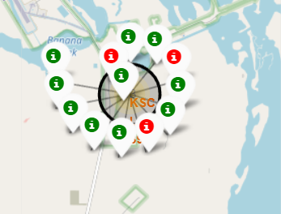
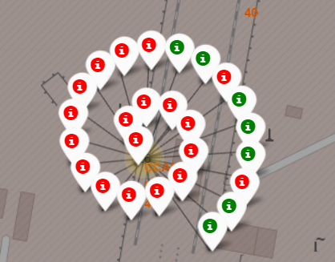
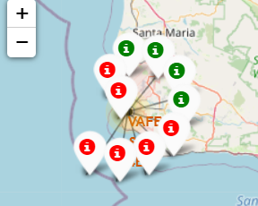
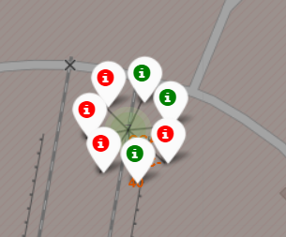
Marked Success/failed launches for each launch site
VAFB SLC-4E
CCAFS LC-40
KSC LC – 39A
CCAFS SLC-40
The four maps show the successful/ failed landing outcomes for each launch site. Green Marker indicates successful launch while Red Marker indicated a failed launch.

Slide 37
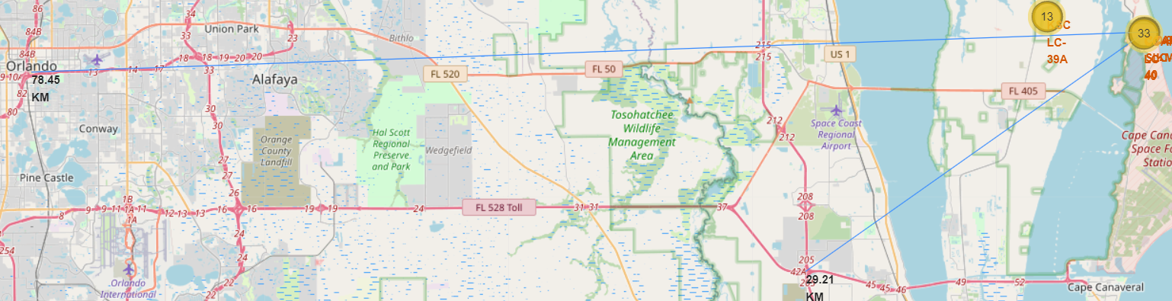
Distances between each launch site to its proximities
The map above shows the distance between launch sites which begin with ‘CCAFS’ to various major highways and their distances are indicated.

Slide 38


Slide 39
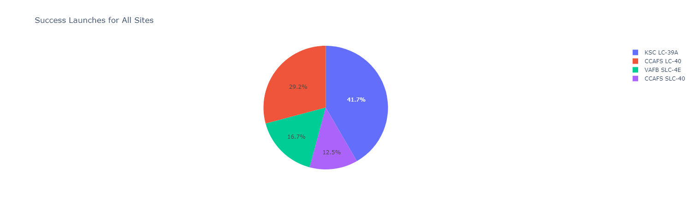
Launch success count for all sites
The Pie chart shows that of all the sites, KSC LC-39A has the most successful launches while CCAFS SLC-40 had the least successful launches.

Slide 40
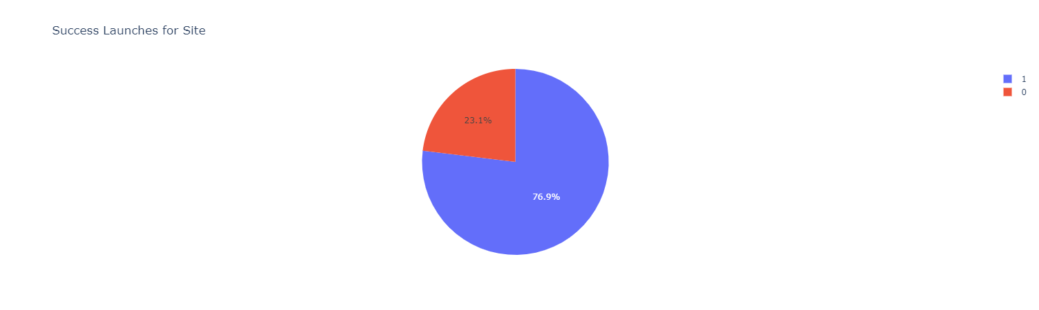
Pie chart for the launch site with highest launch success ratio
The Pie chart above shows that KSC LC-39A achieved a 76.9% success rate while getting a 23.1% failure rate. Thus making it the launch site with the highest launch success ratio

Slide 41
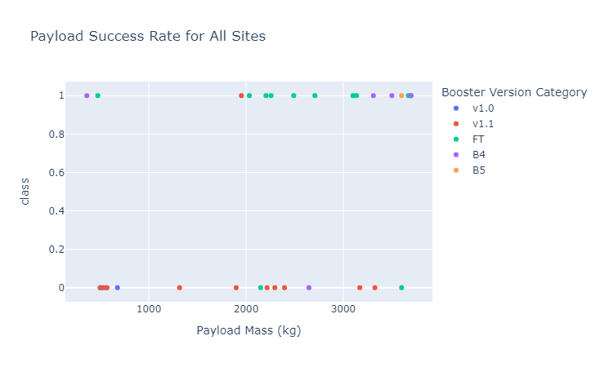
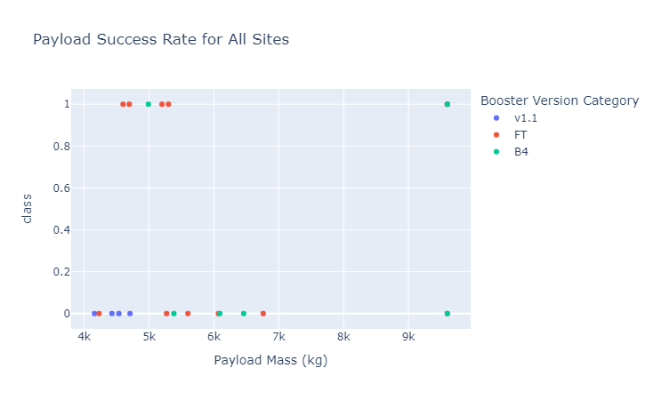
Payload vs. Launch Outcome scatter plot for all
Sites at different payload range
0 - 4000kg
4000 – 10000kg
From the scatter plot graphs above, we see that low weight payload mass have more successful launches than heavy weighted payload mass

Slide 42


Slide 43
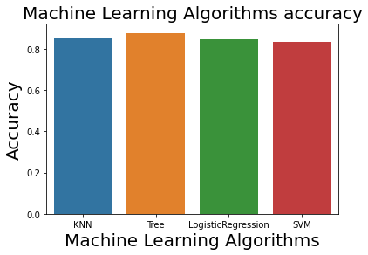
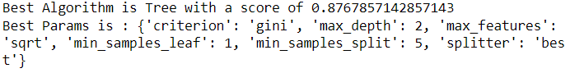
Classification Accuracy
From the Bar chart above, we see that Decision Tree Classifier model was the most accurate model with a score of 87.68%

Slide 44
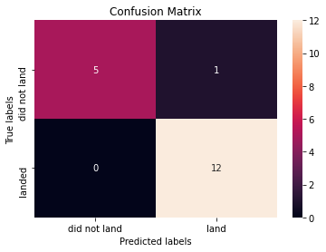
Confusion Matrix
This is the confusion matrix for the Decision Tree Classifier model. Upon close examination, we see that 17 records were predicted correctly while only one record was incorrectly misclassified as landed. This is a good result and thus makes our Model suitable for predicting future landing outcomes.

Slide 45
Conclusions
From our detailed analysis, we can conclude that Low weighted payloads perform better than heavier payloads. This information can prove useful to SpaceX rivals wanting to minimize risk to their rocket launches.
We see that KSC LC-39A had the most successful launches from all the sites.
We observed that Orbit GEO, HEO, SSO, ES-L1 has the best success rate.
The Decision Tree Classifier Algorithm was the most suitable ML algorithm for predicting landing outcome for the dataset.
The more flights taken the better the chance of a successful flight.

Slide 46
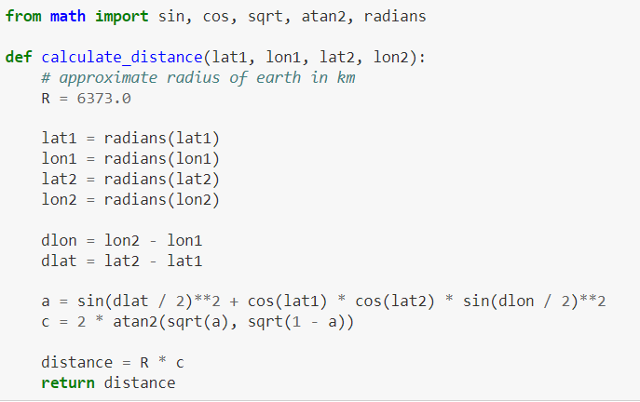
Appendix
Haversine Formula - The Haversine formula calculates the shortest distance between two points on a sphere using their latitudes and longitudes measured along the surface.
The Haversine is:
We applied the Haversine formula when calculating the proximity between each launch site to major highways, railways, etc. This is shown in the code snippet below:

Slide 47


